Slide 1
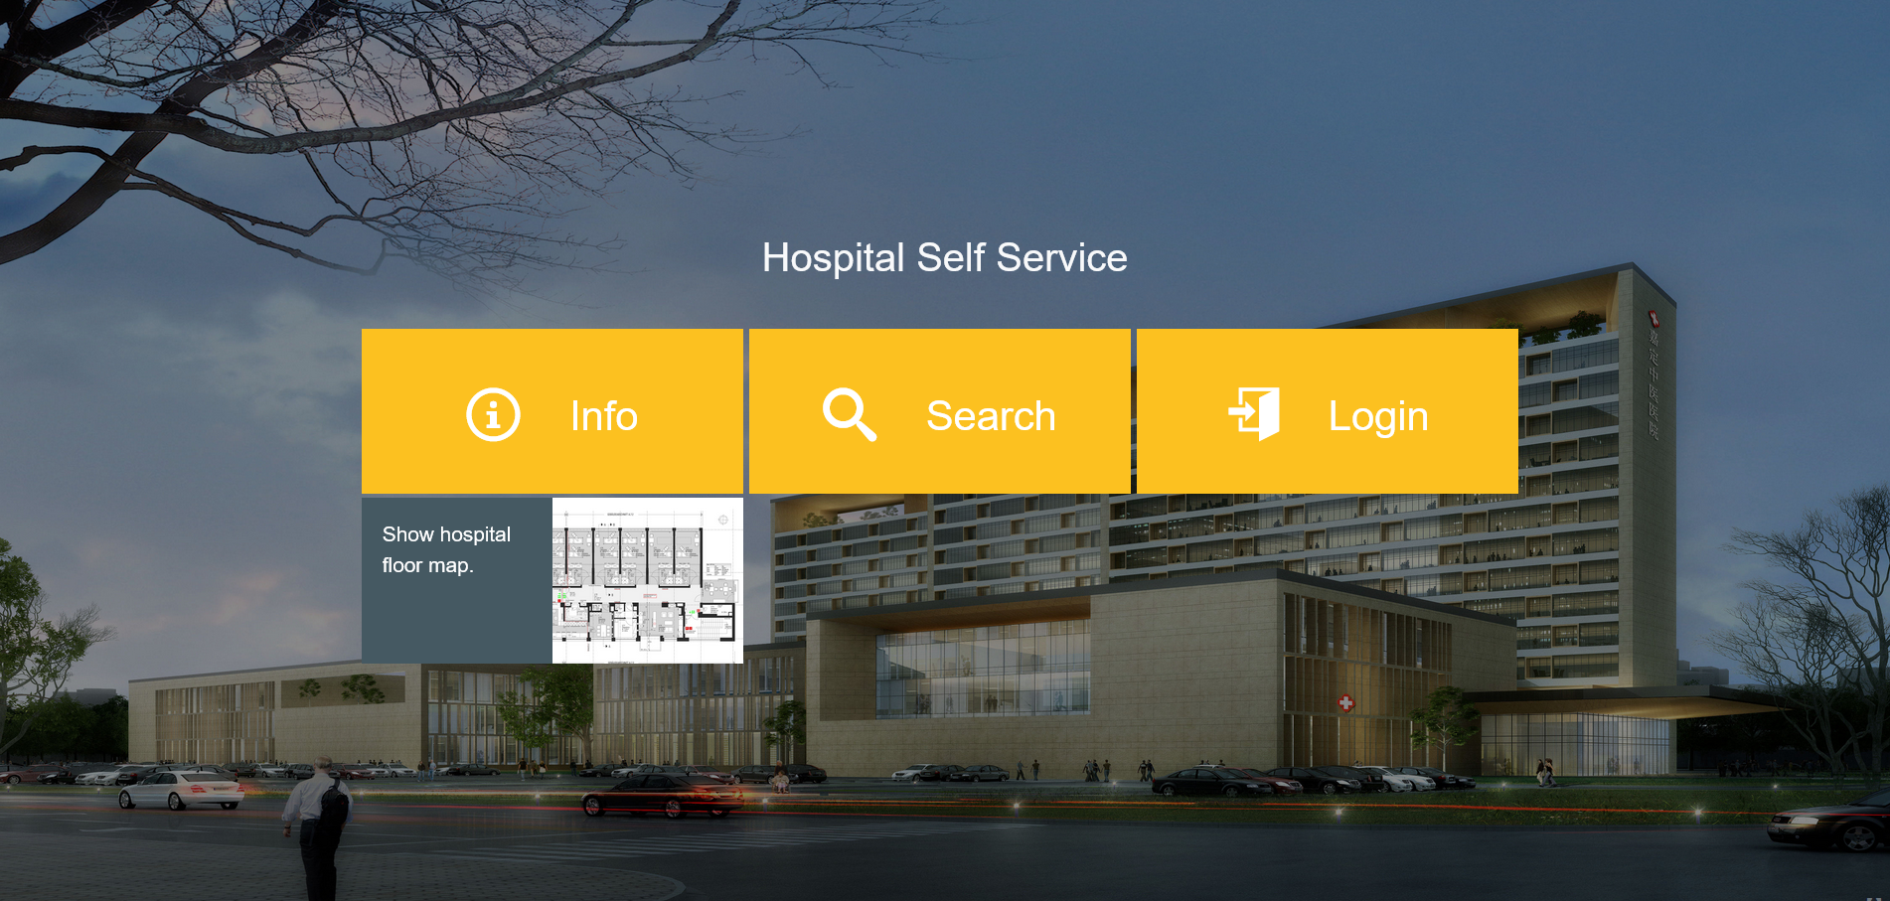



Hospital Self Service the Smart Assistant for health care
Sarah Hönigsberg, Max Scholz, Hendrik Wache, Benedikt Häuser, Christoph Kollwitz

Slide 2
Our Approach
Doctors spend only 27% of their working time with their patients
How can the data from equipment, patients and medical staff be organized, analyzed and visualized to optimize workflows and patient experience?
Analyze requirements
Create a data model
Prototype
Pitch the results
Analyze input data
Choose technology
2

Slide 3
Our Solution
Hospital Self Service
Responsive web application
Multiplatform
Independent from tracking technology
Adaptable and easy to integrate
Supports various stakeholders in hospital operations as well as strategic management
Staff
Patients
Guests

Slide 4
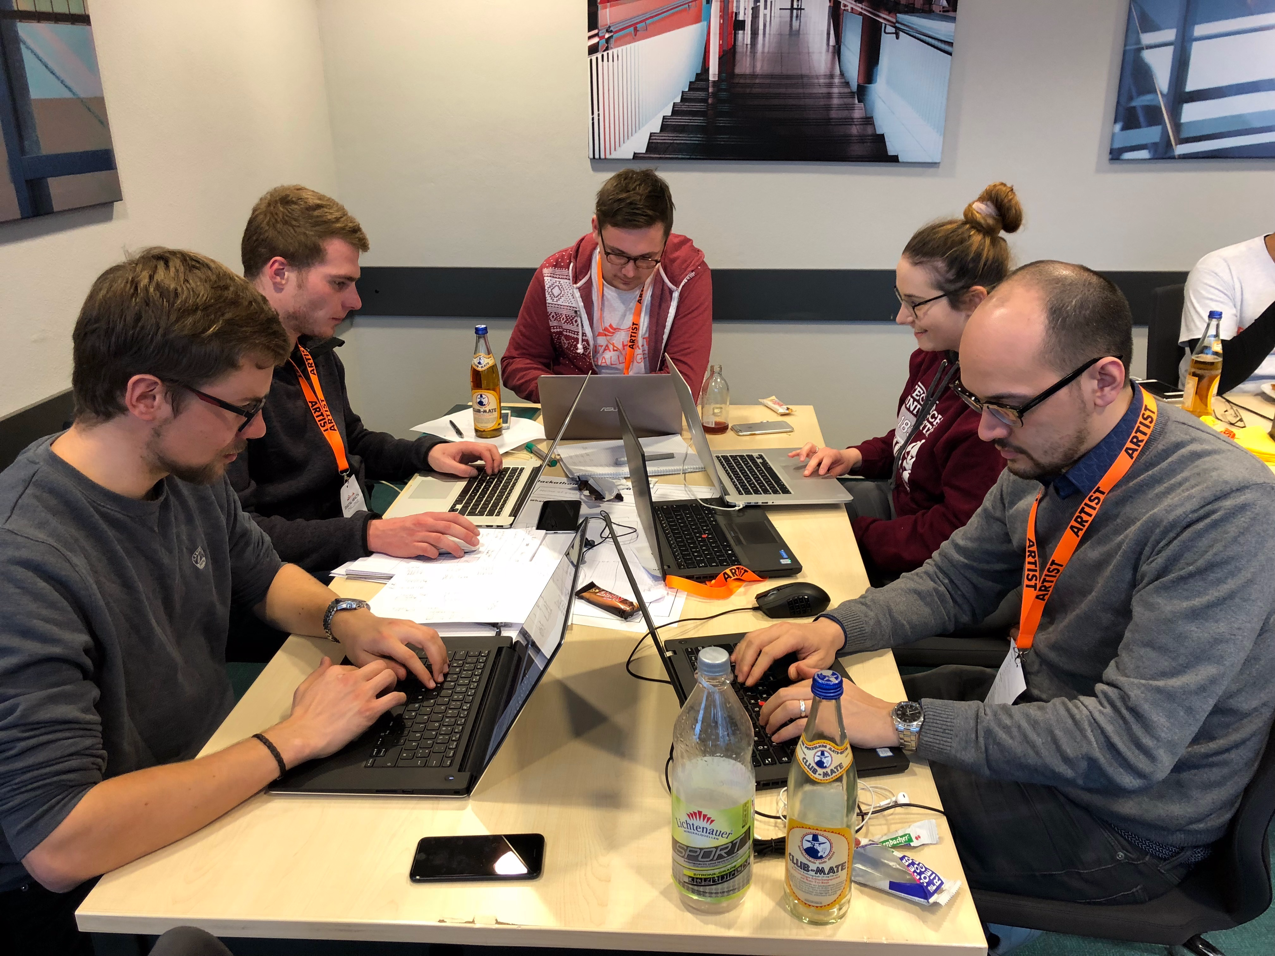

YOur QUestions
Thank you very much for your attention!
Team

